Slide 1


Gradient-based methods or revealing the magic of ML
Danger!!! Math zone
Denys Mytnyk
DSC KPI Kyiv
@tamoshnichek_77

Slide 2
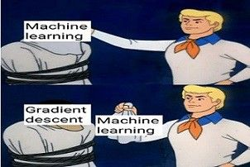


Slide 3
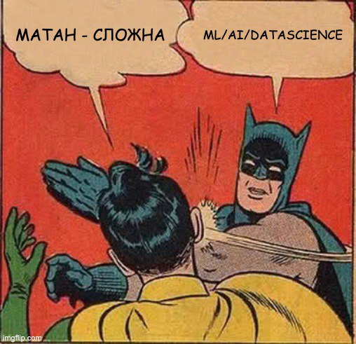
What are we going to discuss?
Multivariable calculus
Partial derivatives
Gradient
Gradient Descent
Applications of GD
Bonus: Newton method

Slide 4
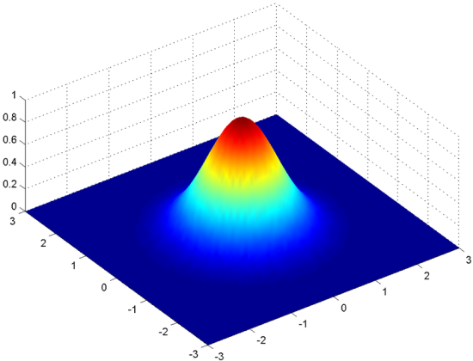
Multivariable calculus
Multivariable calculus (also known as multivariate calculus) is the extension of calculus in one variable to calculus with functions of several variables: the differentiation and integration of functions involving several variables, rather than just one.

Slide 5
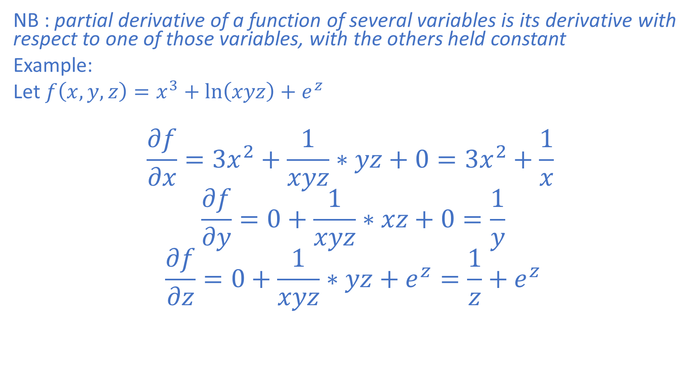
Partial derivatives
NB : partial derivative of a function of several variables is its derivative with respect to one of those variables, with the others held constant
Example:
Let $f\left(x,y,z\right)=x^{3}+\ln\left(xyz\right)+e^{z}$
$$\frac{∂f}{∂x}=3x^{2}+\frac{1}{xyz}∗yz+0=3x^{2}+\frac{1}{x}$$
$$\frac{∂f}{∂y}=0+\frac{1}{xyz}∗xz+0=\frac{1}{y}$$
$$\frac{∂f}{∂z}=0+\frac{1}{xyz}∗yz+e^{z}=\frac{1}{z}+e^{z}$$

Slide 6
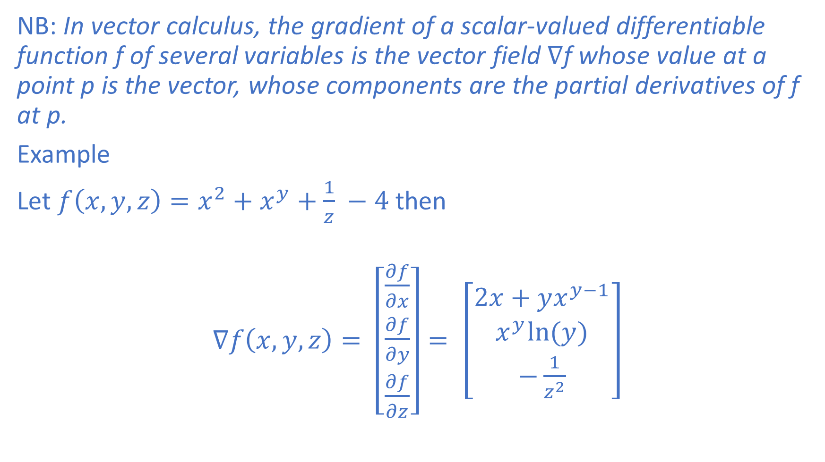
Gradient
NB: In vector calculus, the gradient of a scalar-valued differentiable function f of several variables is the vector field $∇$f whose value at a point p is the vector, whose components are the partial derivatives of f at p.
Example
Let $f\left(x,y,z\right)=x^{2}+x^{y}+\frac{1}{z} −4$ then
$∇f\left(x,y,z\right)= \left[\begin{aligned}\frac{∂f}{∂x} \\ \frac{∂f}{∂y} \\ \frac{∂f}{∂z}\end{aligned}\right]= \left[\begin{aligned}2x+yx^{y−1} \\ x^{y}ln⁡(y) \\ −\frac{1}{z^{2}}&\end{aligned}\right]$

Slide 7
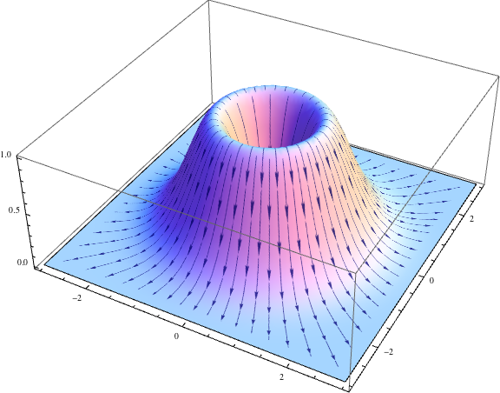
Gradient as a vector field

Slide 8


Slide 9
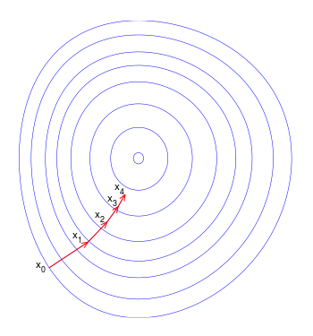
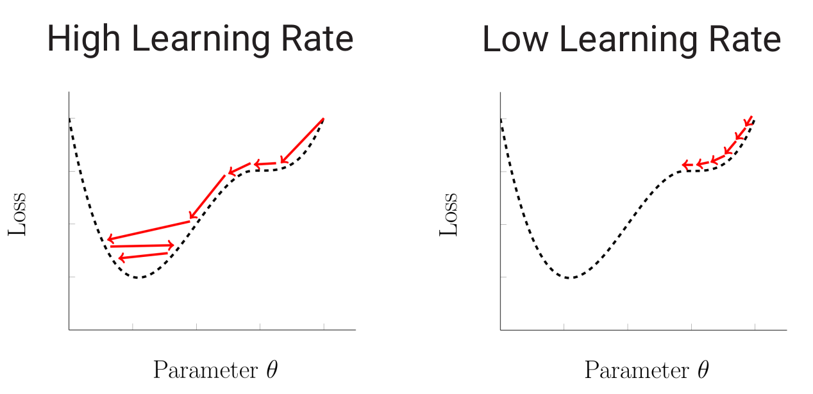
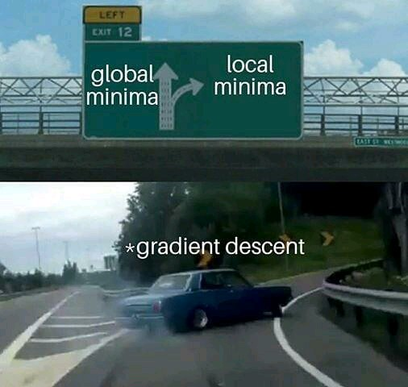

Gradient Descent
Initialize random vector $a_{0}$ = [$x_{1}, x_{2}…x_{n}$]
For i from 0 to epochs:
$a_{n+1}=a_{n} −γ∇F\left(a_{n}\right), where γ−learning rate$

Slide 10
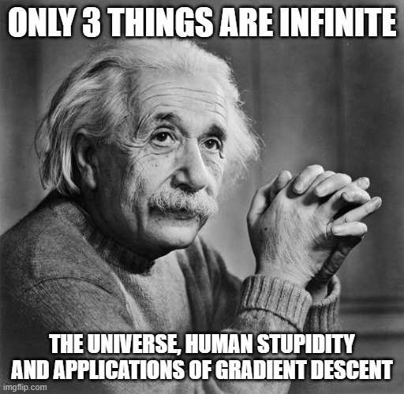
Applications:

Slide 11
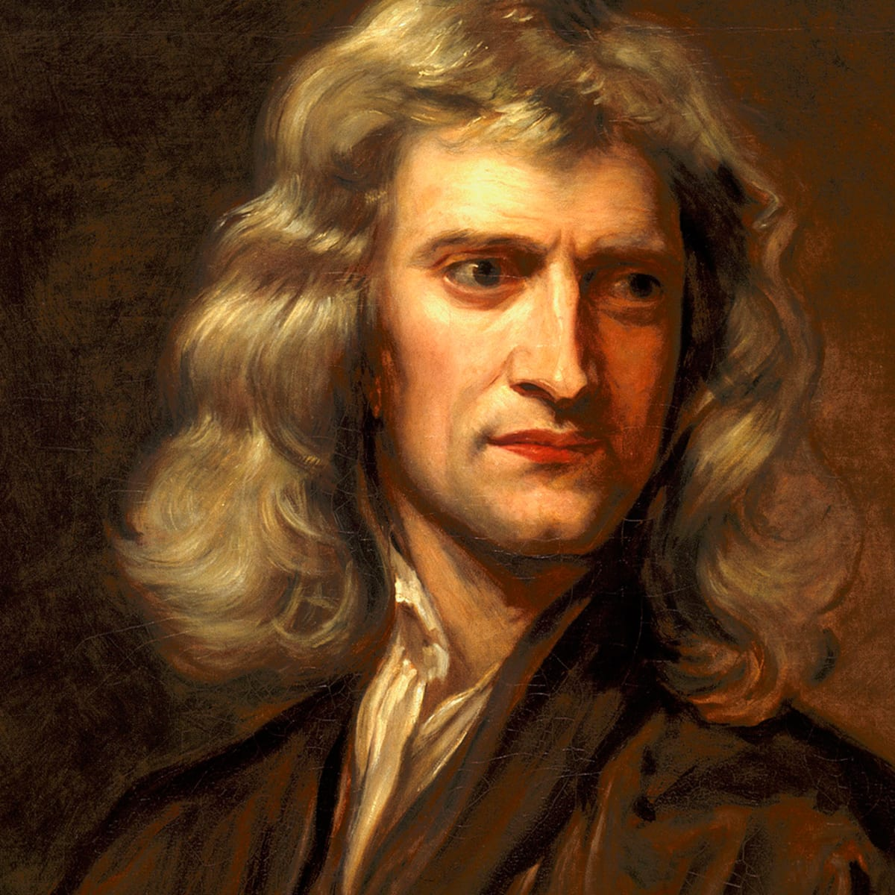
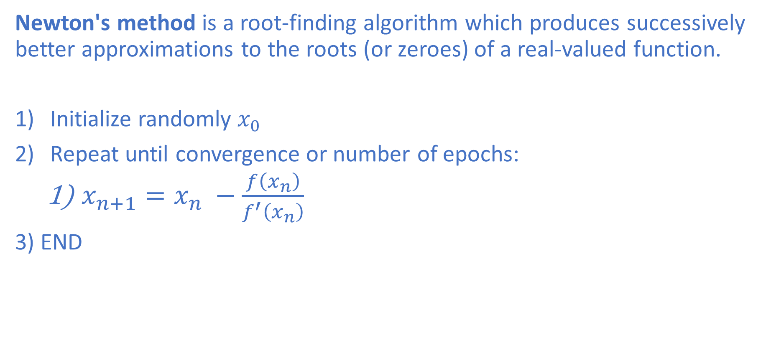
Newton Method
Newton's method is a root-finding algorithm which produces successively better approximations to the roots (or zeroes) of a real-valued function.
Initialize randomly $x_{0}$
Repeat until convergence or number of epochs:
$x_{n+1}=x_{n} −\frac{f\left(x_{n}\right)}{f^{′}\left(x_{n}\right)}$
3) END
Brevity is the soul of wit ☺

Slide 12
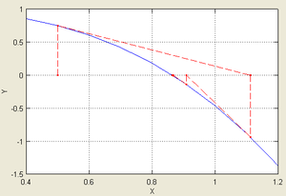
Visualization of Newton’s method
https://www.intmath.com/applications-differentiation/newtons-method-interactive.php

Slide 13
Let’s Code

